Slide 1
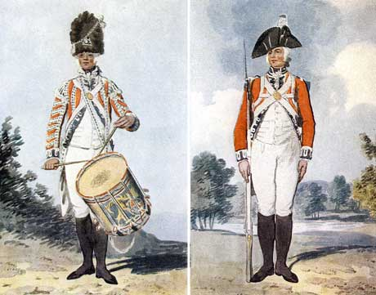
Differentiation
“If a man does not keep pace with his companions, perhaps it is because he hears a different drummer.” Henry David Thoreau (1817-1862)

Slide 2
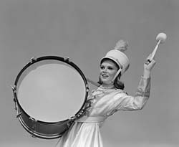

Slide 3

Definitions
What’s your definition of
DIFFERENTIATION?

Slide 4

“…to make unlike; to develop specialized differences in…”
Webster Dictionary
OR
“…shaking up what goes on in the classroom so that the curriculum is a better fit for all.”
Tomlinson, C.

Slide 5
OR..
“Creating multiple options for knowledge acquisition, sense-making, and product creation.”
“providing what is educationally right for learners.”

Slide 6
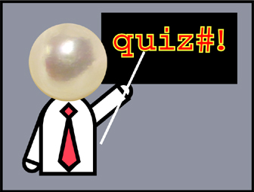
http://people.virginia.edu/~mws6u/diff/quiz.php

Slide 7
By the end of this session..
All will be inspired to attempt new differentiated learning strategies
Some will feel happier about the paperwork
A few may go on to write an essay about it…

Slide 8


Why?
Requirement
“Initial teacher training education programmes will include training on delivering sessions with differentiated outcomes and activities.” (SVUK)

Slide 9
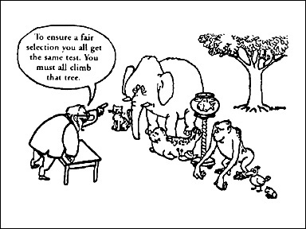
Moving from this …

Slide 10
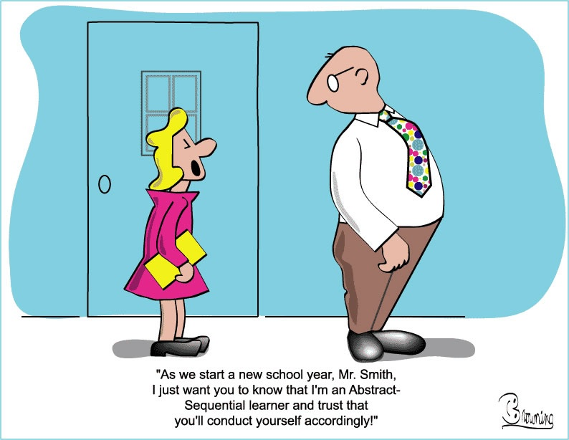
to this….

Slide 11
Why do it?
” two motivational states interfere with learning. One is anxiety; the other is boredom. Anxiety occurs when teachers expect too much, boredom when they expect too little.
Mihaly Csikezentmihalyi
Flow: the Psychology of Optimal Experience

Slide 12
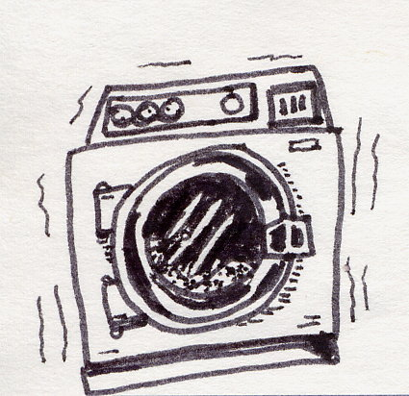
Normal is only a setting on the washing machine!
When we teach the same thing to all learners at the same time,
1/3 already know it
1/3 get it, and
1/3 never will.
so 2/3 of our students are wasting their time.
Scott Willis

Slide 13
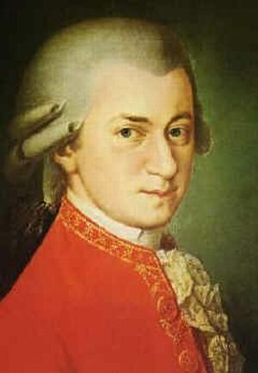

Who are we teaching?
If they had attended your school .. Would they have been expelled?
Mozart+ different
Jesus+ a general attitude problem

Slide 14
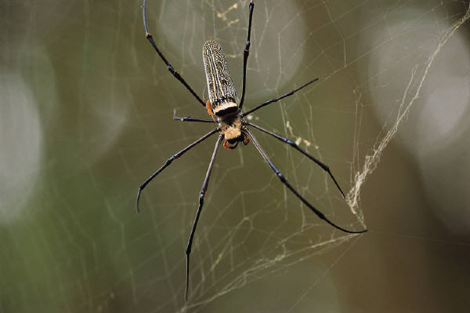
Who ?
A learner type for every leg of this spider…
Notes:
Role play game

Slide 15
Learning Styles

Slide 16
How to do it…?
A lot of exhortations and not much advice….

Slide 17
What can be differentiated?
CONTENT
PROCESS
PRODUCT
LEARNING ENVIRONMENT
Notes:
Elicit environment drawing

Slide 18
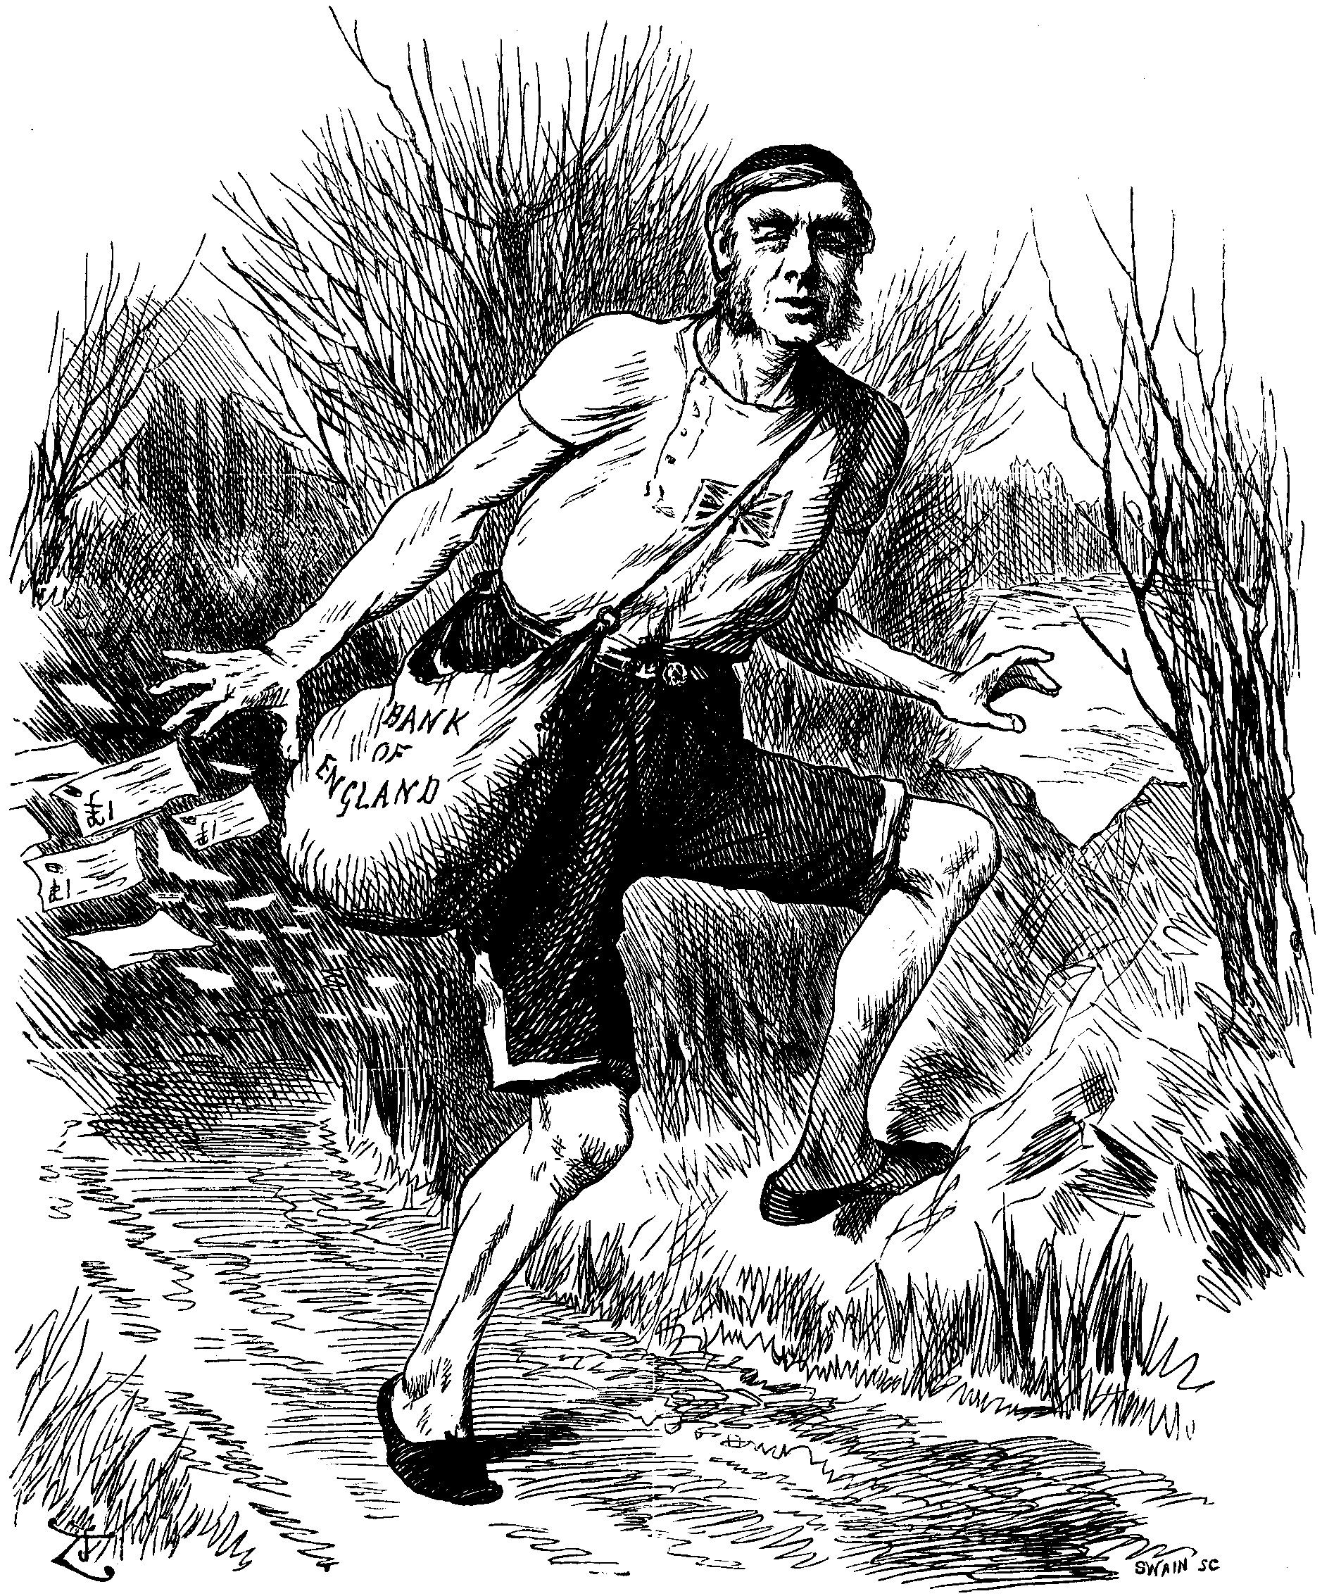
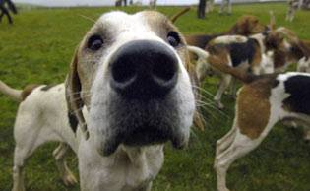

Problems?
(Everest, C.2007)
http://education.guardian.co.uk/egweekly/story/0,5500,897299,00.html)
Notes:
The hounds bear their teeth with threats of redundancy
and the hares produce so much paper that they can barely stumble along the track strewn with it..”

Slide 19

Learning styles….VAK
Each to their own.. or “theoretically and psychometrically flawed”
Coffield, F 2004
http://education.guardian.co.uk/schools/story/0,5500,1495588,00.html
Notes:
Coffield a literature review carried out last year. This article 2005We need a kite mark… Claxton to help people sort the wheat from the chaff. It’s one model amongst many

Slide 20

Individualised learning or
Learners responsible for their own unemployment and poverty?

Slide 21

Differentiated learning…
By…..
S
O
A
I
T
T
Notes:
Case study- mine or theirs

Slide 22

What does your class look like?
Think about a group you teach who have very different profiles.
How can you differentiate their learning?

Slide 23
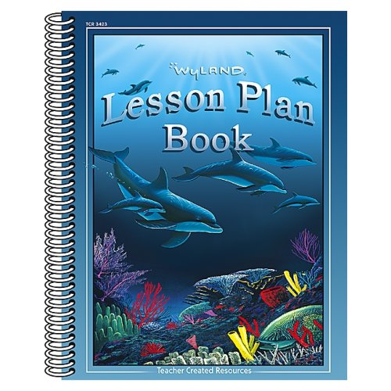
Differentiated session plans?

Slide 24

If you want to feel safe and secure, keep on doing what you’re doing… but

Slide 25
Differentiation or Autonomy
“When pedagogy is not specifically focused on the development of autonomy,some learners achieve but the majority do not.”
(Little, D. 2000)
Notes:
Little, D. In Green S. (2000) New perspectives on teaching and learning Modern languages Multilingual Matters Clevedon

Slide 26
Moving from this …

Slide 27
Bibliography
http://chiron.valdosta.edu/whuitt/col/cogsys/bloom.html
http://www.caroltomlinson.com/
Accessed 15.10.07

